Slide 1


Slide 2

Investing and Stock Market Basics

Slide 3

Investment
An investment is an asset or item that is purchased with the hope that it will generate income or appreciate in value at some point in the future. In words of Robert Kiyosaki- “Investment is making money work for you, instead of you working for money”
Need to invest
Fight Inflation- By investing one can deal better with growing cost of living – Inflation
Create wealth-children’s education, marriage, house purchase, retirement holidays, etc
To meet life Financial aspirations

Slide 4
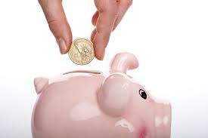
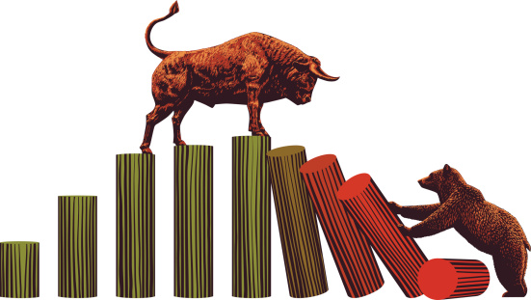


Where to invest?
Fixed Income instruments
Equity
Real estate
Commodity

Slide 5
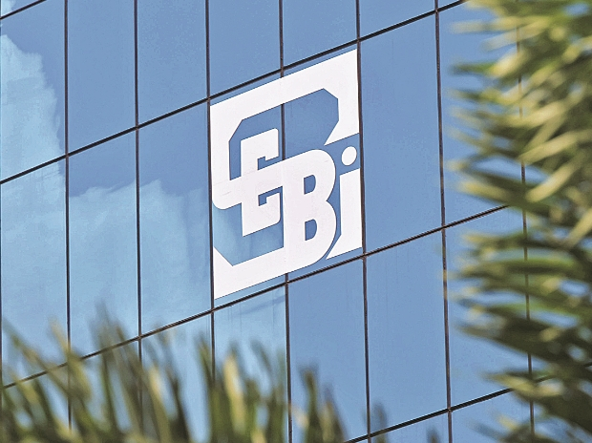
Regulator-Security and Exchange Board of India
The stock exchanges (BSE and NSE) conducts its business fairly
Stockbrokers and sub-brokers conduct their business fairly
Participants don’t get involved in unfair practices
Corporate’s don’t use the markets to unduly benefit themselves (Example – Satyam Computers)
Small retail investors interests are protected
Large investors with huge cash pile should not manipulate the markets
Overall development of markets

Slide 6
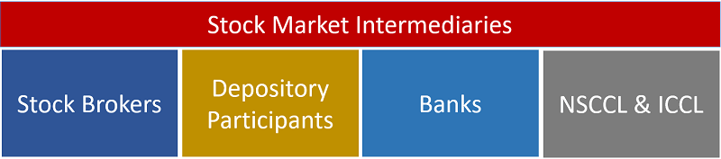
Financial Intermediaries
Stock broker- A stockbroker provides you with a trading account which is used for all market-related transactions (buying and selling of financial instruments like shares)
Depository and Depository Participants-A Depository is a corporate entity which holds the shares in electronic form, against your name, in your account. Your account with the depository is called the ‘DEMAT’ account. There are only two depositories in India – NSDL and CDSL. To open a DEMAT account with one of the depositaries, you need to liaison with a Depository Participant (DP). A DP functions as an agent to the Depository
Banks- They help in facilitating the fund transfer from your bank account to your trading account.
NSCCL and ICCL-National Security Clearing Corporation Ltd and Indian Clearing Corporation works towards clearing and settling of trades executed by you.

Slide 7
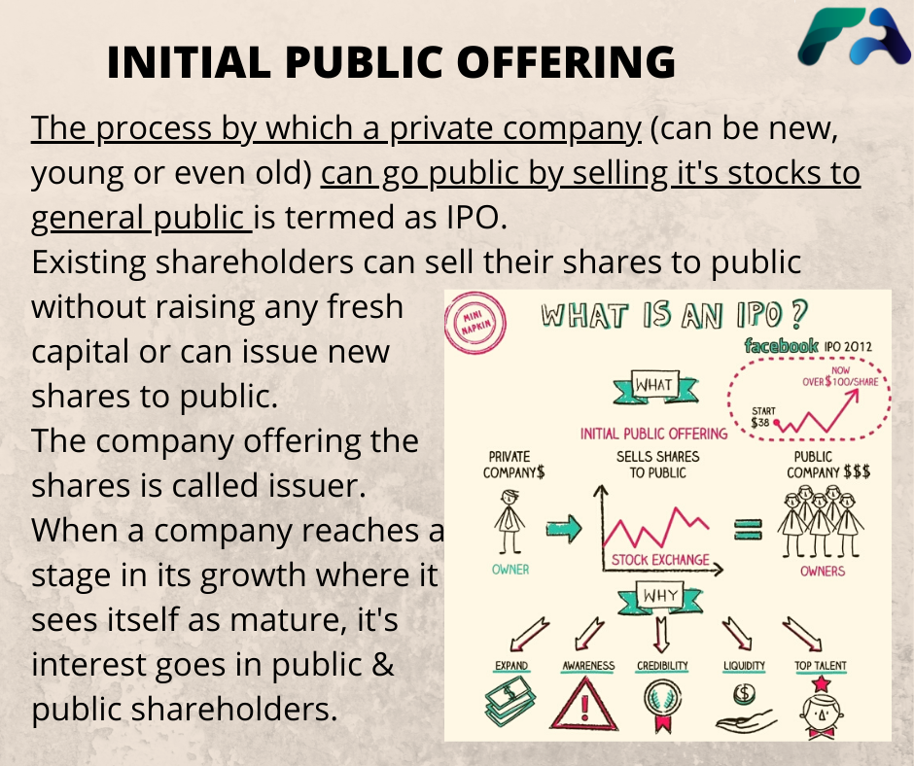
IPO –Initial Public Offering

Slide 8
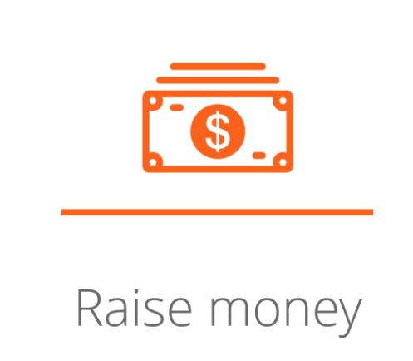
Why do companies go public?
Raising funds to meet CAPEX(Capital Expenditure) requirement
Repay Debt
Provide an Exit for Early Investors
Reward Employees
Improve Visibility
Spread risk

Slide 9
IPO Jargons
Undersubscription- When the number of shares bid for is lower than what is available on offer
Oversubscription- When the number of shares bid for is higher than what is available on offer
Green Shoe Option - Part of the underwriting agreement which allows the issuer to authorize additional shares (typically 15 percent) to be distributed in the event of oversubscription. This is also called the overallotment option
Price Band and Cut off price -Price band is a price range between which the stock gets listed. For example, if the price band is between Rs.100 and Rs.130, then the issue can list within the range. Let’s says it gets listed at 125, then 125 is called the cut off price.
Fixed Price IPO –Sometimes the companies fix the price of the IPO and do not opt for a price band. Such issues are called fixed price IPO

Slide 10
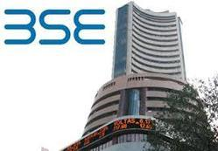
Stock Market
A stock market is a place where a trader or an investor can transact (buy, sell) in shares
A stock market is a place where the buyer and seller meet electronically
Different opinions makes a market
The stock exchange electronically facilitate the meeting of buyers, and sellers
News and events moves the stock prices on a daily basis
Demand supply mismatch also makes the stock prices move
When you own a stock you get corporate privileges like bonus, dividends, rights etc
Holding period of a stock is defined as the period during which you hold your shares

Slide 11

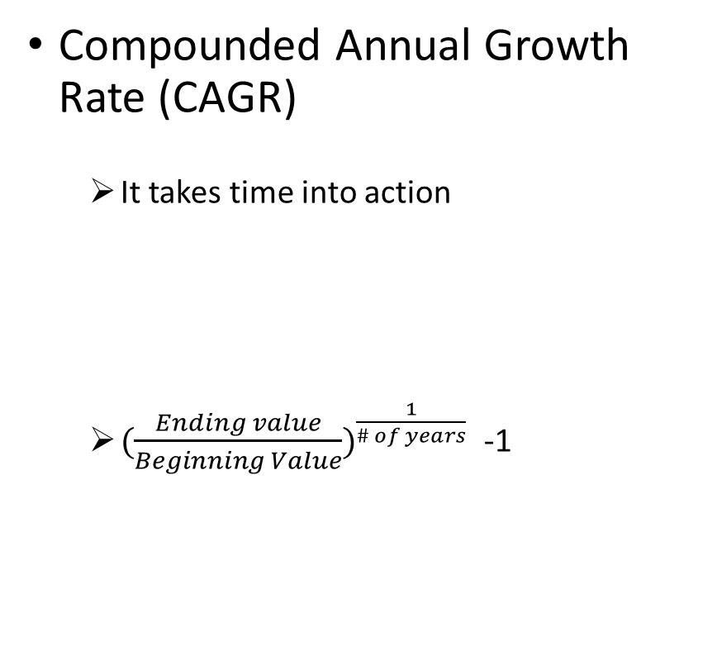
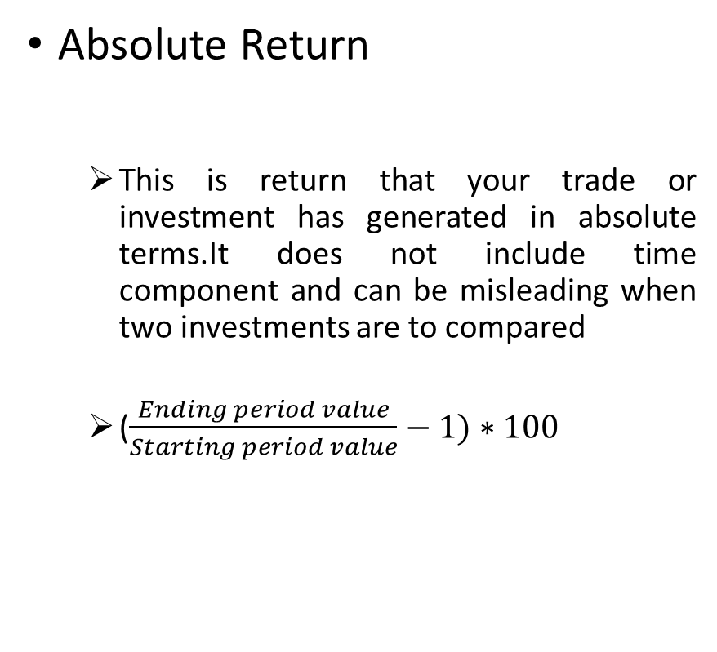
Calculation of return
Absolute Return
This is return that your trade or investment has generated in absolute terms.It does not include time component and can be misleading when two investments are to compared
($\frac{Ending period value}{Starting period value}−1)∗100$
Compounded Annual Growth Rate (CAGR)
It takes time into action
${(\frac{Ending value}{Beginning Value})}^{\frac{1}{\# of years}}$ -1

Slide 12




Stock Market Index & its Need
A stock market index acts as a barometer for whole economy as it is indicates whether the market participants are optimistic or pessimistic about the market. An index going up indicates that the market participants are optimistic. An index going down indicates that the market participants are pessimistic. Practical uses of index are as follows:
Information
Trading
Benchmarking
Portfolio Hedging

Slide 13

Indian Stock Market Index
There are many ways to assign weights, but the Indian stock exchange follows a free-float market capitalization method. The weights are assigned based on the company’s free-float market capitalization, the larger the market capitalization, the higher is the weight.
Free float market capitalization is the product of the total number of shares outstanding in the market and the stock price.
There are two main indices in India – The BSE Sensex and NSE’s Nifty
As of today, Nifty has 50 Indian Stock Companies (14 important sectors) in which Reliance Industries Ltd. has maximum weightage of 10.66% . Sensex on the other hand has 30 well-established and financially sound companies
There are sector-specific indices which convey the sentiment of specific sectors.

Slide 14
Commonly used Jargons in Stock Market
Bull Market(Bullish)-If you believe that the stock prices are likely to go up, you are bullish on the stock price.
Bear Market(Bearish)-If you believe that the stock prices are likely to go down, you are bearish on the stock price.
Trend – The term ‘trend’ usually refers to the general market direction and its associated strength.
Long Position-If you buy some stock, you are said to take a long position
Short Position-Selling a stock first with the intend that you can later buy it at a lower price, then you are said to take a short position
Square off ­– Square off is a term used to indicate that you intend to close an existing position.
Intraday position – This is a trading position you initiate with an expectation to square off the position within the same day.
OHLC ­– OHLC stands for open, high, low and close. For more details we will be giving lectures on Technical Analysis.So, Stay tuned!
Volume- Volumes represent the total transactions (both buy and sell put together) for a particular stock on a particular day.

Slide 15
Terminologies
There are various basic Terminologies which are required and we must know while Investing
Stop Loss
Open price, Close price, HIGH ,Low.
Ask Price
Bid Price
Volumes
CNC
NRML OR MIS

Slide 16
Clearing and settlement process
Now we want to understand what happens behind the scene from the time you buy a stock to the time it hits your DEMAT account.
The day we purchase or sell stock is called T day .
Suppose on 18 Jan (Monday) you purchase 10 stocks of reliance industries then 18 Jan is your T day
on this day the amount would be debited from the account .
19 Jan would be our T+1 day on this day you can sell the stocks called “Buy Today Sell Tomorrow”
(BTST), “Acquired Today, Sell Tomorrow”(ATST). But the stock is still not in your account so there is
risk involved in selling stock on T+1 day.

Slide 17
T+2 day, around 11 AM shares are debited from the person who sold you the shares and credited to the brokerage with whom you are trading, who will in turn credit it to your DEMAT account by the end of the day.
The day you sell the stocks is again called the trading day, represented as ‘T Day’. The moment you sell the stock from your DEMAT account, the stock gets blocked. Before the T+2 day, the blocked shares are given to the exchange. On T+2 day you would receive the funds from the sale which will be credited to your trading account after deduction of all applicable charges.
Now what happens when we sell stock?

Slide 18
Corporate action and their effect on stocks .
Corporate actions are initiatives taken up by a corporate entity that brings in a change to its stock there are various initiatives :
Dividends :Dividends are a means of rewarding shareholders. The dividend is announced as a percentage of the face value . If we want get dividend we must hold the share of company atleast
2days before company list down all their shareholder for dividend.
Bonus Issue : A bonus issue is a form of the stock dividend. This is the company’s way of rewarding the shareholders with additional shares.

Slide 19
Stock split : A stock split is done based on the face value. The face value and the stock price changes in proportion to the change in face value
Rights issue : Is a way through which the company raises fresh capital from the existing shareholders. Subscribe to it only if you think it makes sense
Buy back of shares : Buyback signals a positive outlook of the promoters. This also conveys to the shareholders that the promoters are optimistic about the company’s prospects.

Slide 20
Events and their impact on market
As an investor we must know about the various event taking in market due to which the stocks of a particular company is Affected Markets and individual stocks react to events. Some of the significant events are :
MONETORY POLICY : Monetary policy is one of the most important economic events. During the monetary policy, review actions on a repo, reverse repo etc. are initiated.
Repo rate
Rate at which banks borrow money from RBI.
Reverse repo
Rate at which RBI borrow money from banks .

Slide 21
INFLATION: Inflation is a sustained increase in the general prices of goods and services. Increasing inflation erodes the purchasing power of money.
Index of Industrial Production (IIP):The Index of Industrial Production (IIP) is a short-term indicator of how the country’s industrial sector is progressing. IIP measures industrial production activity. Increase in IIP cheers the markets, and lower IIP disappoints the market.
Purchasing Managers Index (PMI): The Purchasing managers’ index (PMI) is an economic indicator that tries to capture business activity across the country’s manufacturing and service sectors. PMI is a survey-based business sentiment indicator.

Slide 22
Budget: A Budget is an event during which the Ministry of Finance discusses the country’s finance in detail. The Budget is an important market event where policy announcements and reform initiatives are taken. Markets and stocks react strongly to budget announcements.
Corporate Earnings Announcement: The listed companies (trading on the stock exchange) must declare their earning numbers once in every quarter, also called the quarterly earnings numbers.
Stocks react mainly due to the variance in actual number versus the street’s expectation.

Slide 23
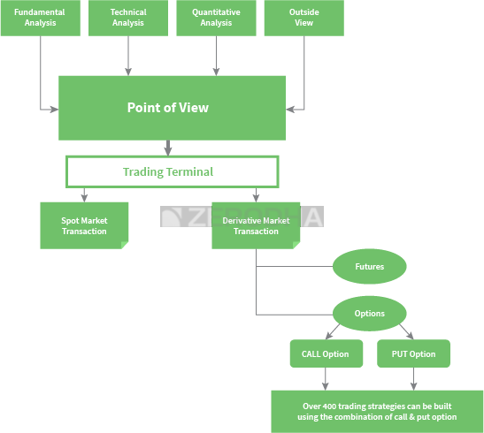
Way forward to get started ….

Slide 24
Some other terms ..
IPO: An initial public offering (IPO) refers to the process of offering shares of a private corporation to the public in a new stock issuance. Public share issuance allows a company to raise capital from public investors.
FPO: A follow-on public offering (FPO) is the issuance of shares to investors by a company listed on a stock exchange. A follow-on offering is an issuance of additional shares made by a company after an initial public offering (IPO). Follow-on offerings are also known as secondary offerings.
OFS: Offer for sale (OFS) is a simpler method of share sale through the exchange platform for listed companies.

Slide 25
Difference Between OFS and FPOS
An OFS is used to offload Promoters’ shares while an FPO is used to fund new projects.
Dilution of shares is allowed in an FPO leading to change in Shareholding structure while OFS does not affect the number of authorized shares.
Only the top 200 companies by Market Capitalisation can use the OFS route to raise funds while all listed companies can use FPO option.

Slide 26
THANK YOU !!!
HOPE TO SEE YOU AGAIN….

